Slide 1

Beacons + AppBuilder = <3
Jen Looper
Developer Advocate, Telerik
@jenlooper

Slide 2
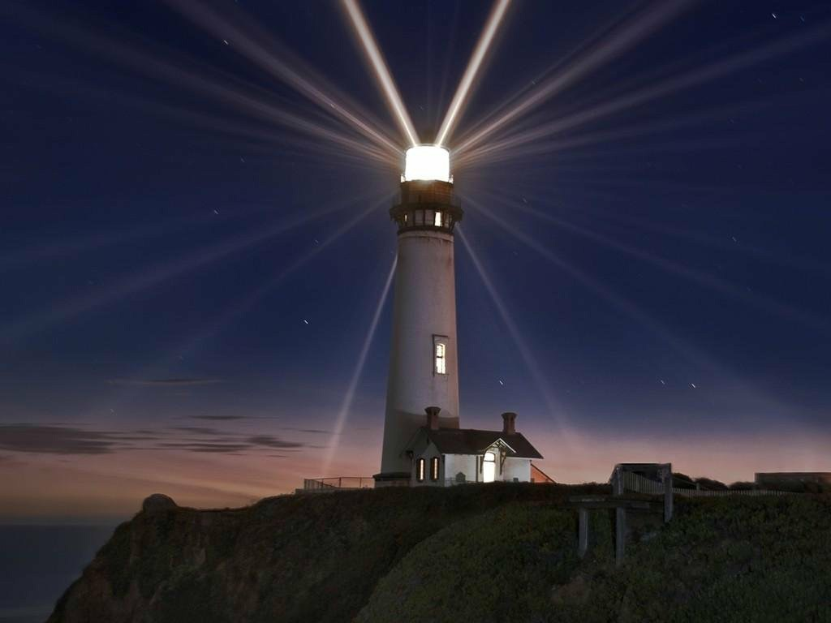

Beacons!

Slide 3
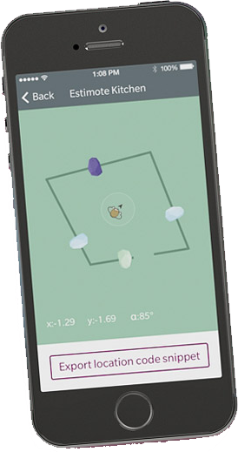
Except much more precise: indoor location FTW
Use several beacons to triangulate your location in a room

Slide 4
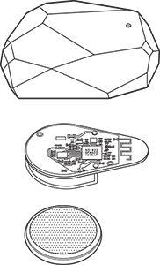
Beacons might feature:
A bit of memory
Accelerometer
Temperature sensor
Bluetooth (Smart, or BLE)
Long-lived battery
Gecko-style sticky backing

Slide 5
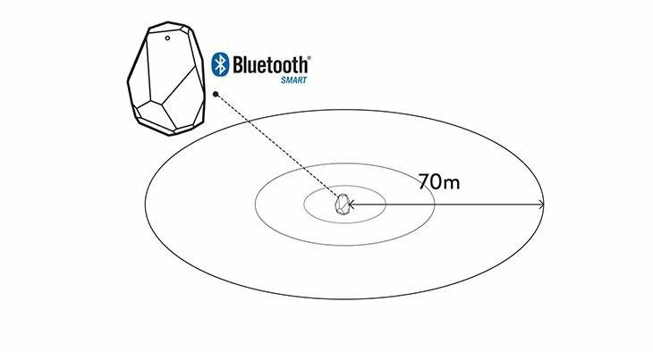
Bluetooth signal
Beacons broadcast using bluetooth
Find them between two inches and 230 feet distance
Invisible underwater

Slide 6
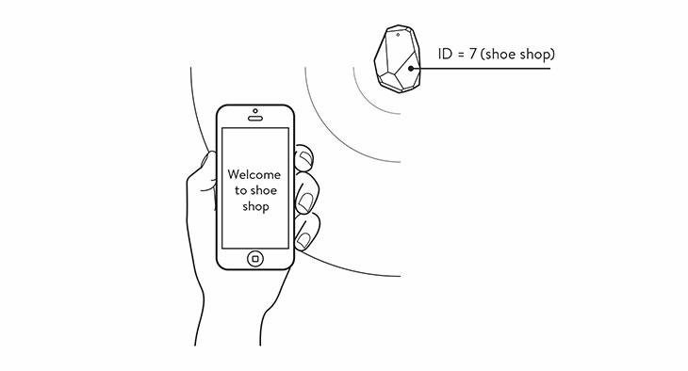
Your phone picks up a signal (“advertising packet”) and your app processes it
Estimates distance
Places phone in a context
Measures signal strength
Can ping 10x/second

Slide 7
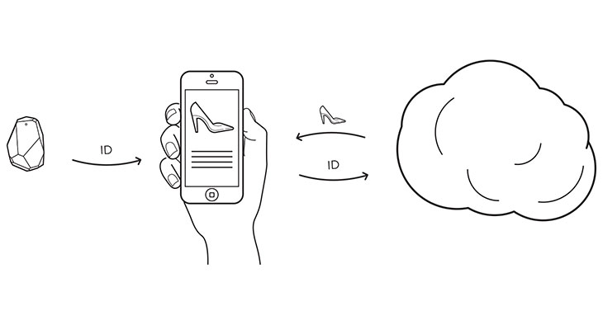
Beacons have a unique Id
Associate this id with a product or a call to action

Slide 8
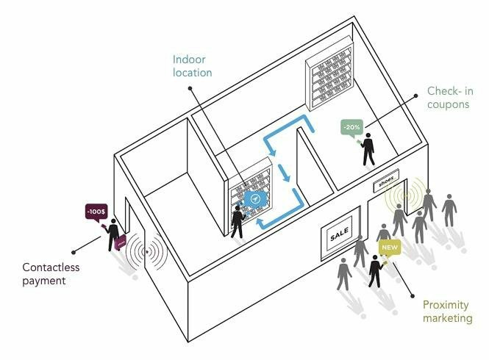
And moar!
Micro-location
Geofence users
Detect context changes
Proximity marketing
Turn-by-turn navigation

Slide 9
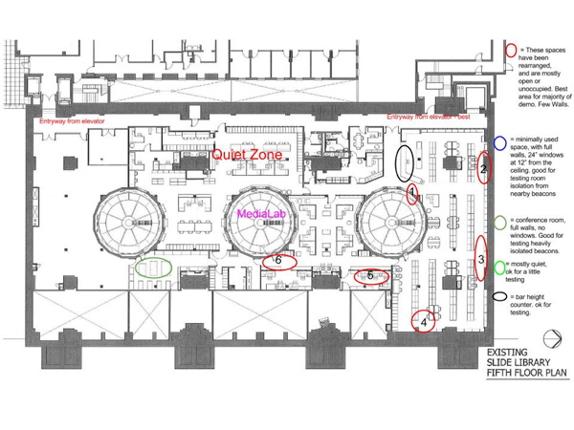
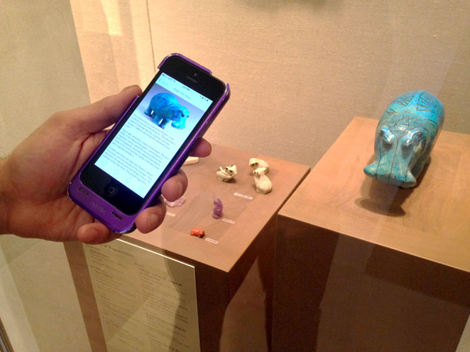
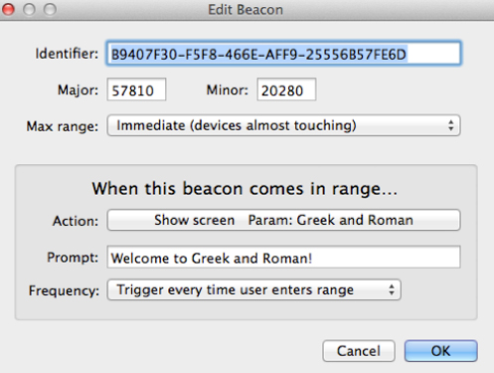
Museums!! Check out the Metropolitan Museum’s ‘Beacon Walk’
http://bit.ly/met-museum-beacon
Uses Estimotes with Beacondo service

Slide 10
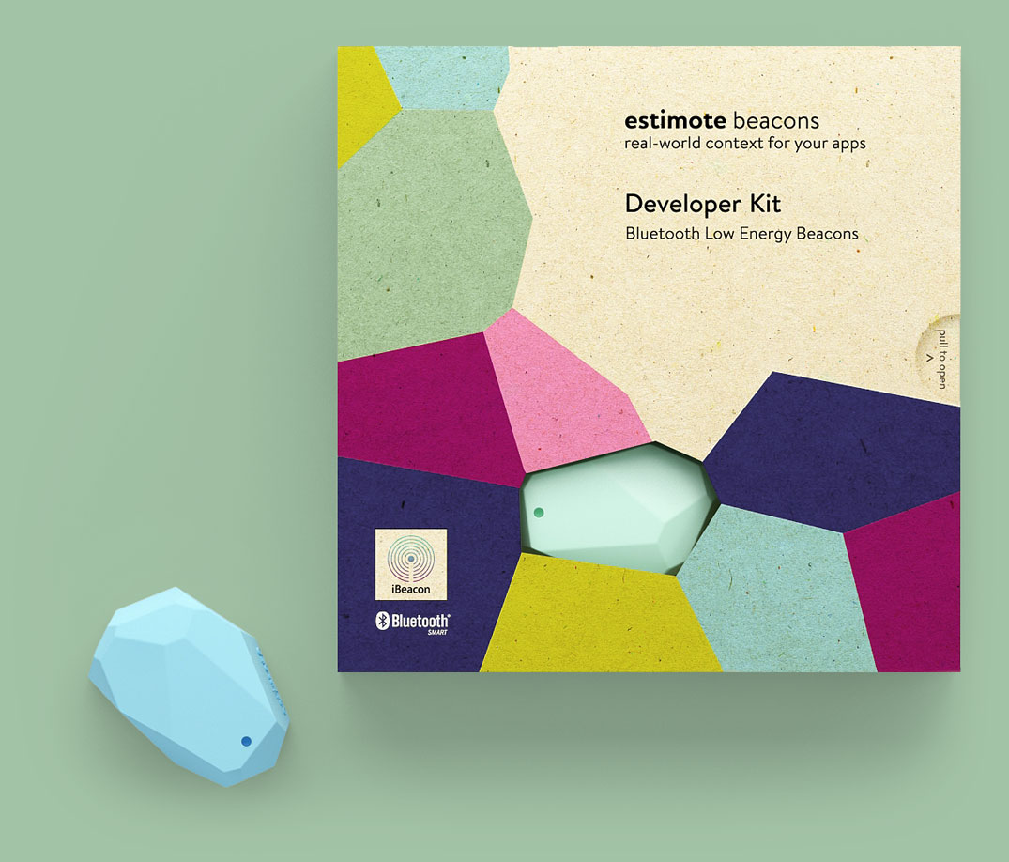

What about iBeacon?
iBeacon is a protocol created by Apple, for iOS 7 and 8 devices
Many hardware beacons leverage iBeacon technology

Slide 11
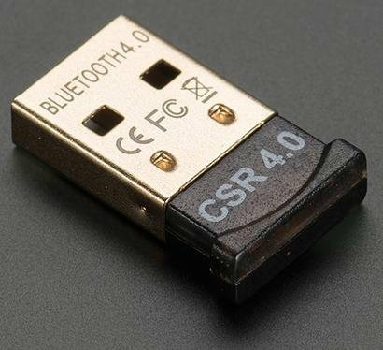
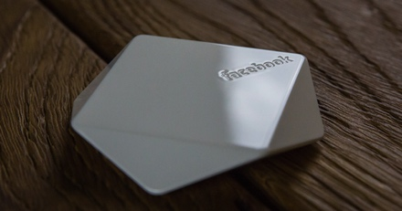
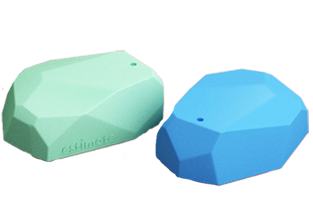
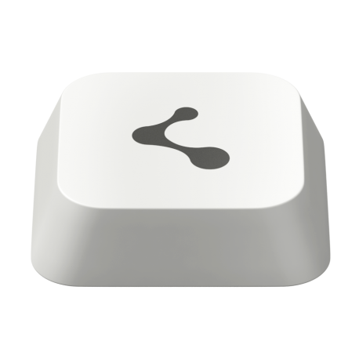
What types of hardware beacons are available now?
DIY – Bluetooth dongle can be turned into a beacon
Facebook Bluetooth Beacons
Estimote beacons
Kontakt.io beacons

Slide 12

Periculum!

Slide 13
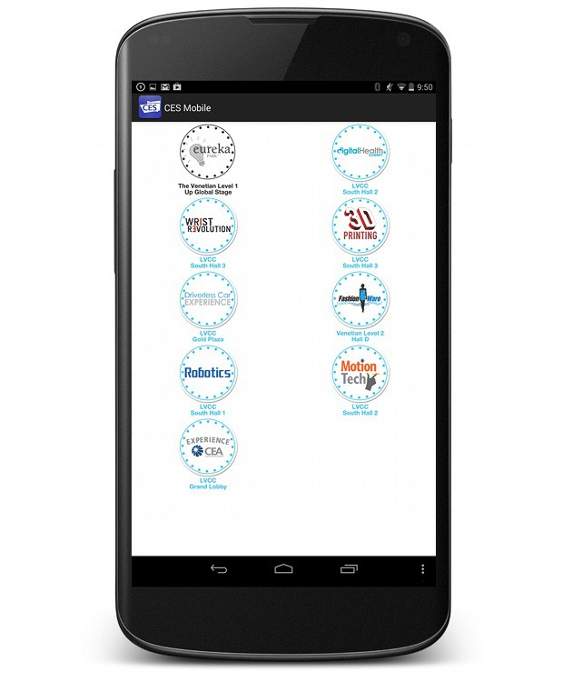
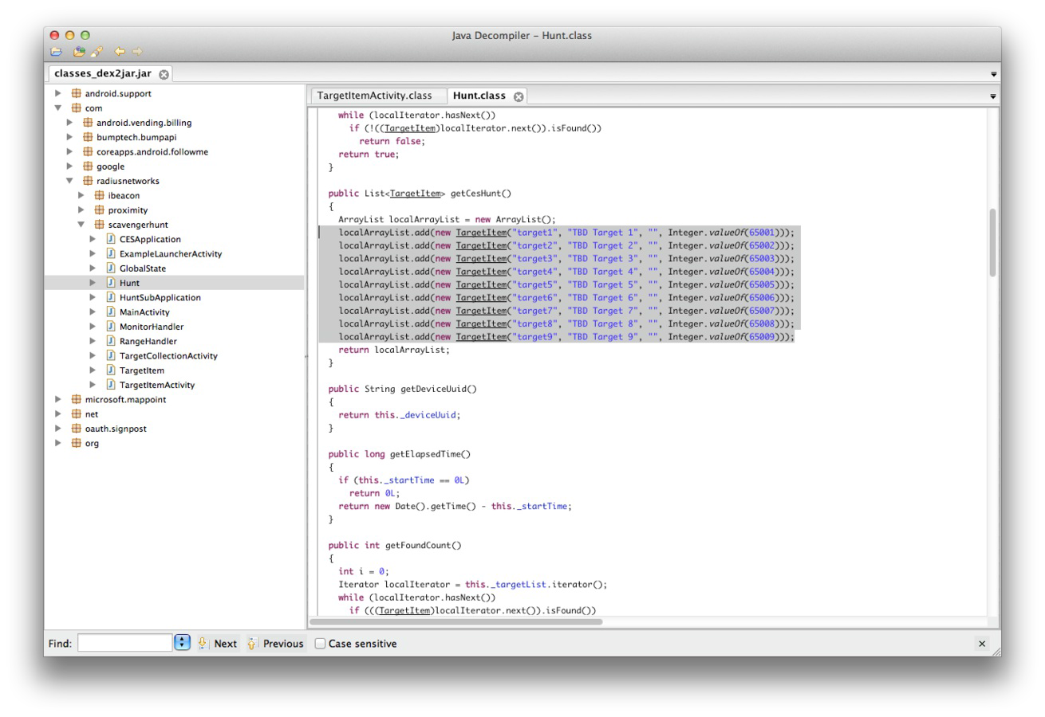
Beacons can be hacked
☹
→

Slide 14

Hacking the CES scavenger hunt
http://bit.ly/ces-hack

Slide 15
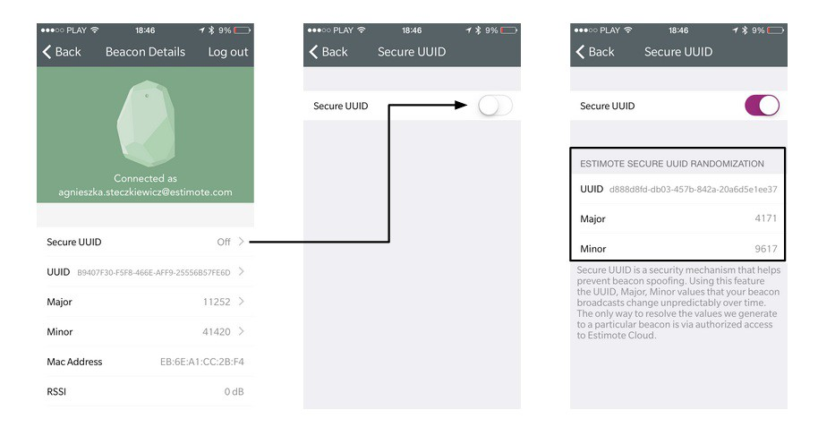
Estimotes have beefed up security
Manage your beacons’ UUIDs

Slide 16
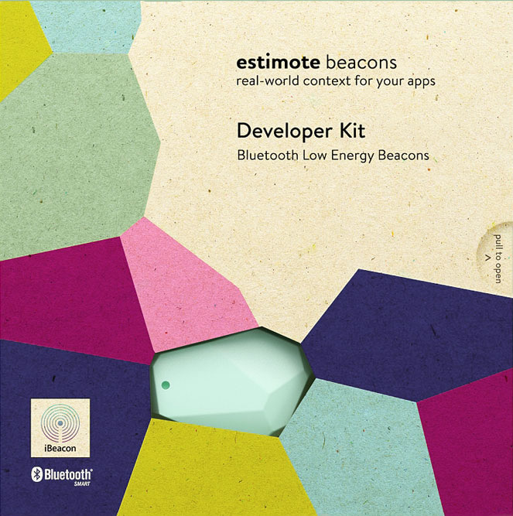
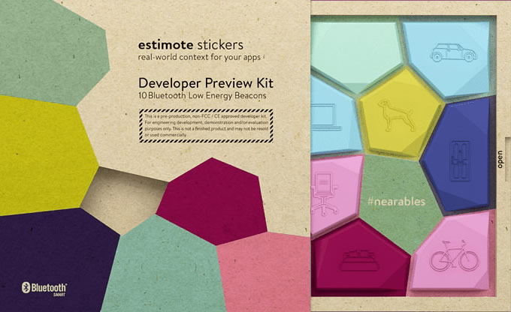
A look at Estimote’s offering
Beacons and Stickers, $99 per pack, SDK + Cloud

Slide 17
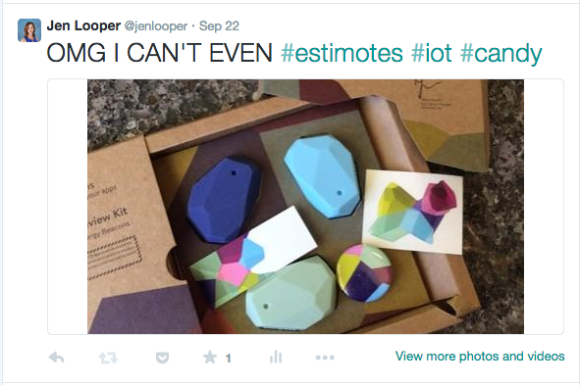
The unboxing

Slide 18

Let’s build something!

Slide 19
Beacon Hunt
Full tutorial:
http://bit.ly/beacon-hunt
Github repo:
https://github.com/jlooper/beacon-hunt.git

Slide 20

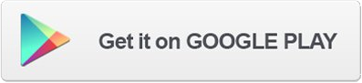
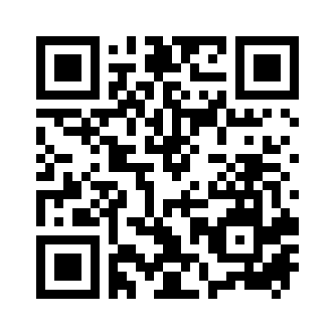
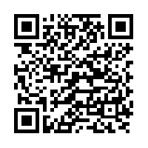
Introducing Beacon Hunt!

Slide 21
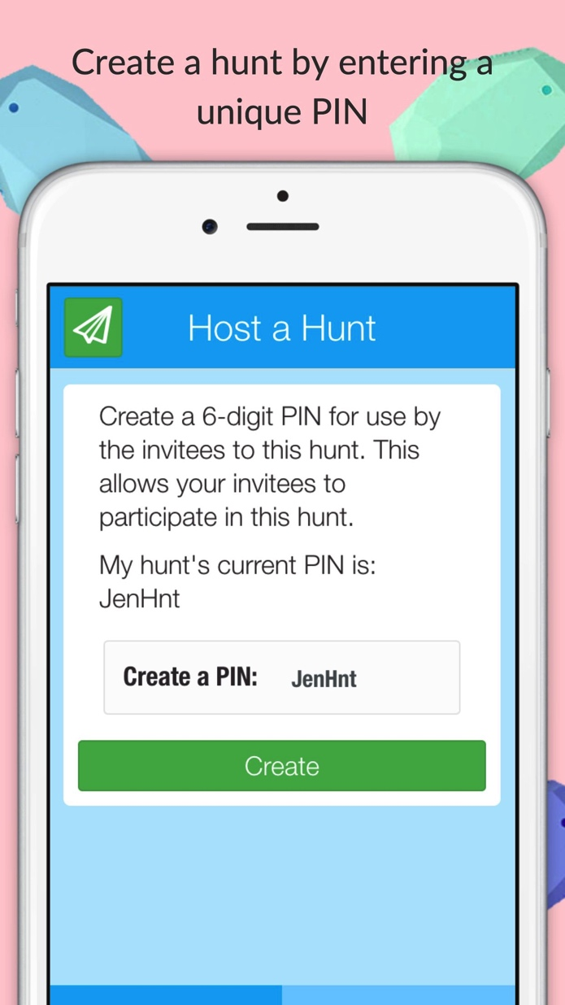
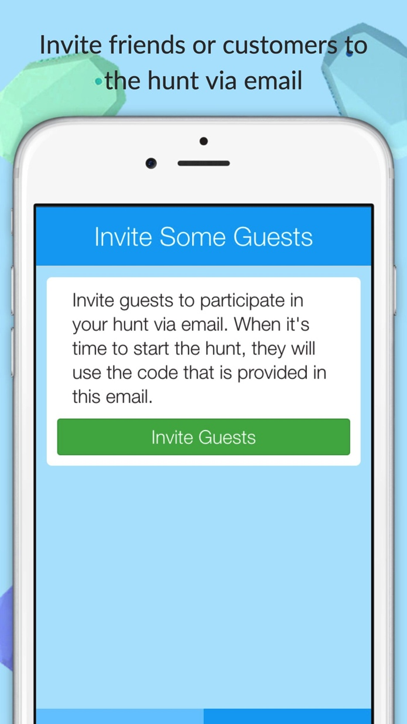
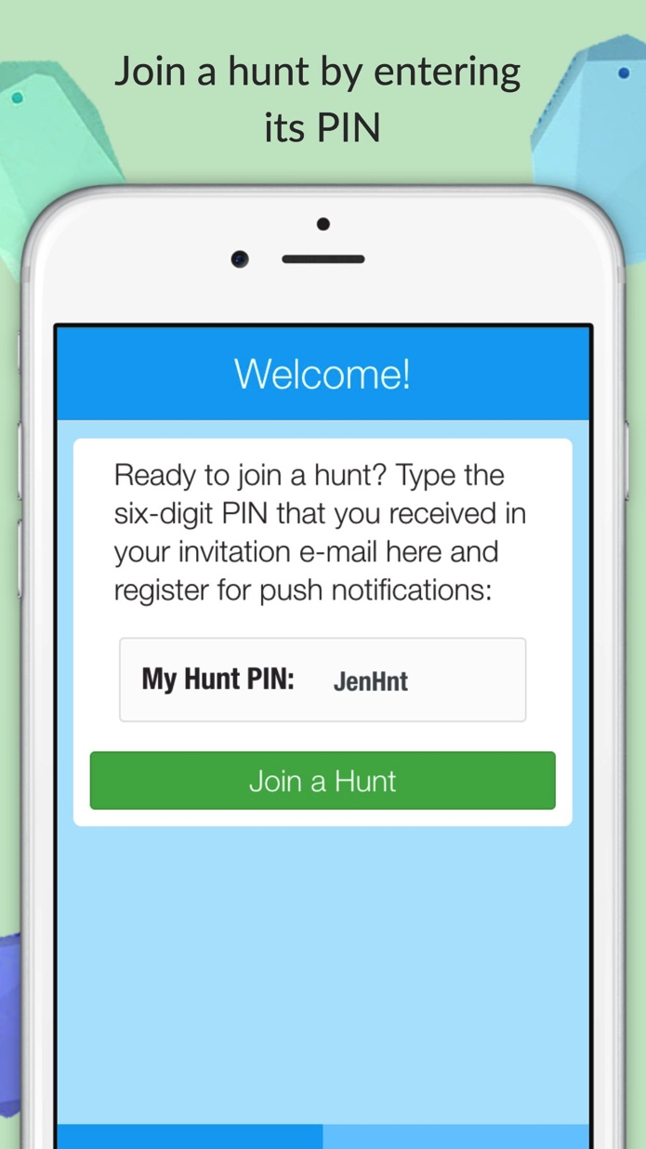
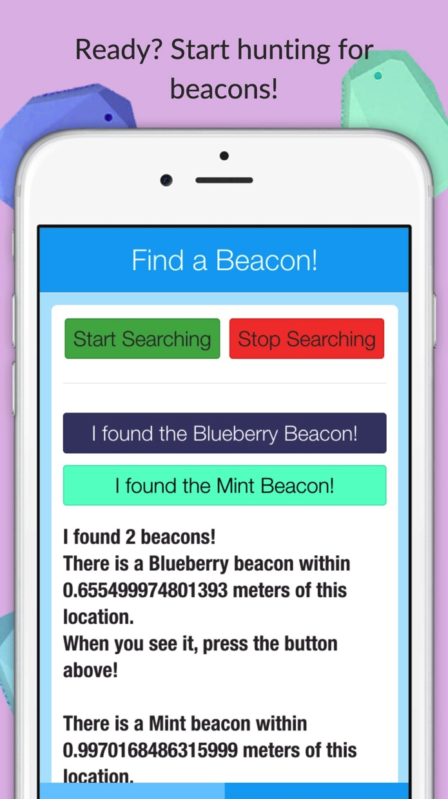
Estimote Beacons + Plugin + AppBuilder + Telerik Backend Services = fun app!

Slide 22
Beacon Hunt Requirements:
Allow an administrator or host to create a Beacon Hunt by creating a 6-digit PIN unique to that hunt
Enable sending this PIN to users of the app via email
Allow invitees to the hunt to input the PIN and subscribe to a push notification channel unique to the hunt
On push of ‘start’ button, app starts pinging for beacons
If beacon is found, appropriately colored button is generated, and when pressed, a push notification is sent to the members of the hunt that this color beacon has been found (“claimed”).

Slide 23
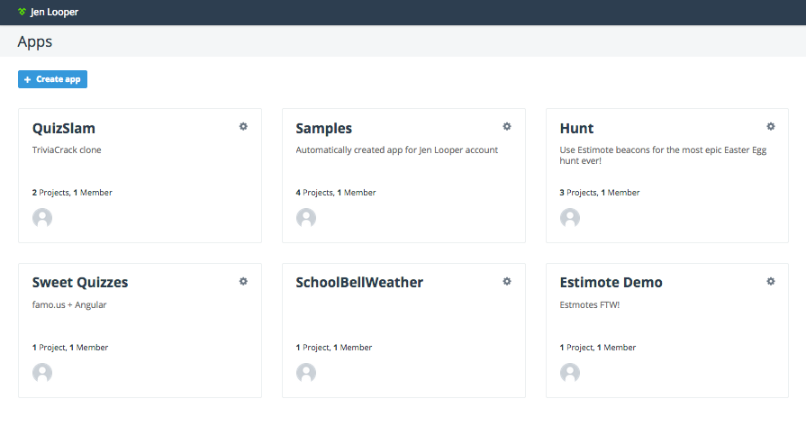
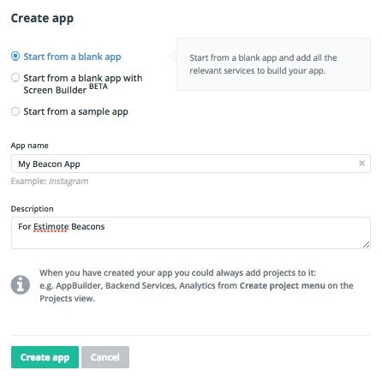
Building the app – Step 1 - Setup
Create an account at platform.telerik.com and create an app
Using Telerik Platform makes it easy

Slide 24
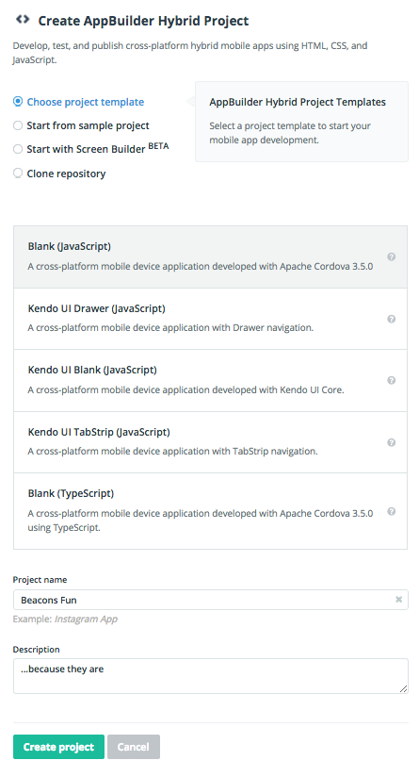
Building the app – Step 2 – Scaffold
Scaffold a basic Kendo UI Mobile app
Create a hybrid project using a blank JavaScript template

Slide 25
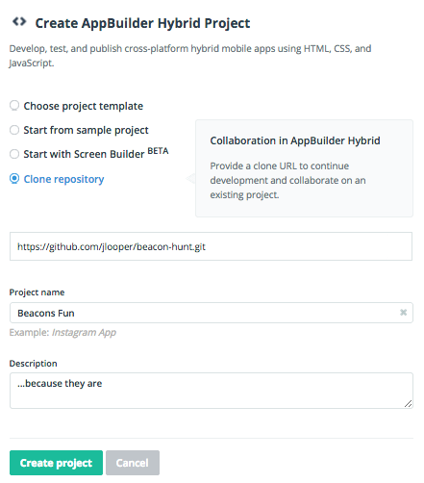
Building the app – (quick ‘n’ dirty)
Scaffold your app using code from github
https://github.com/jlooper/beacon-hunt.git

Slide 26
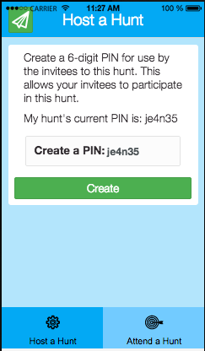
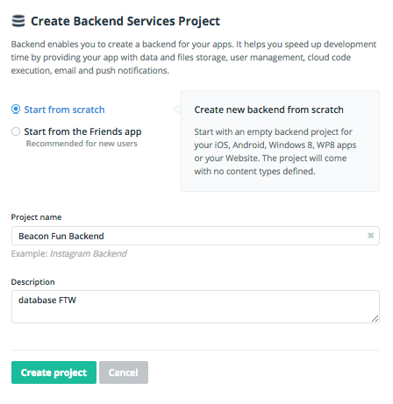
Adding the backend
A 6 digit PIN will reserve your hunt ID. Use Telerik Backend Services to store it.
Add Backend Services to your project to store data

Slide 27
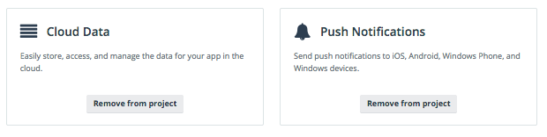
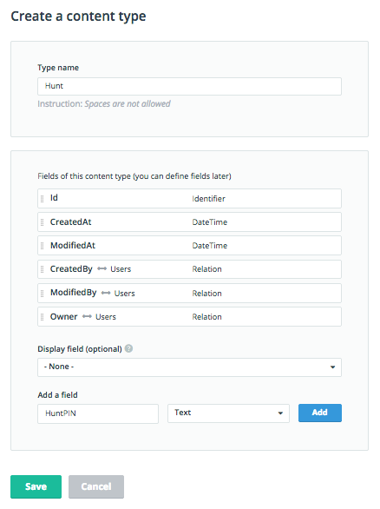
Add cloud data
Add push notifications and cloud data to your app project’s backend configuration
Create a ‘content type’ to store HuntPINs so they will remain unique for use as push segments

Slide 28
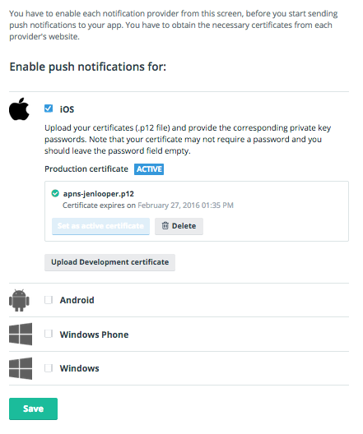
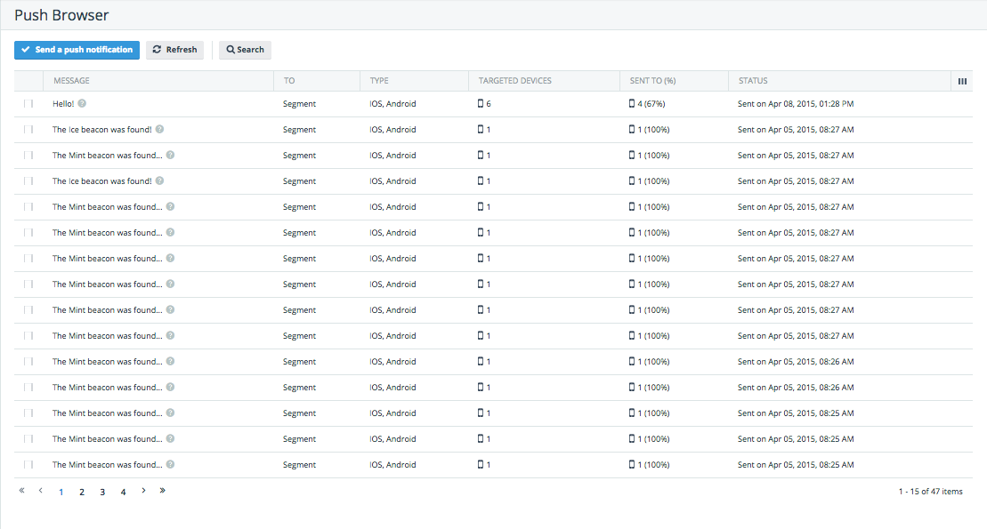
Configure push notifications
Manage your app provisioning (takes time to do on iOS especially!)
Keep track of push stats in the backend

Slide 29
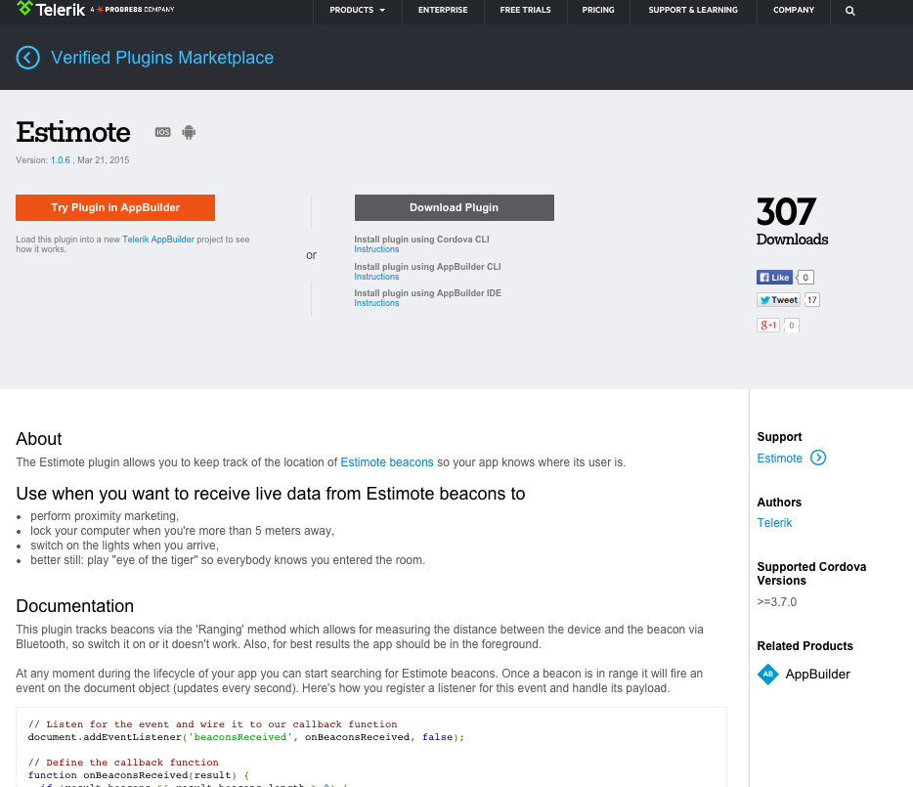
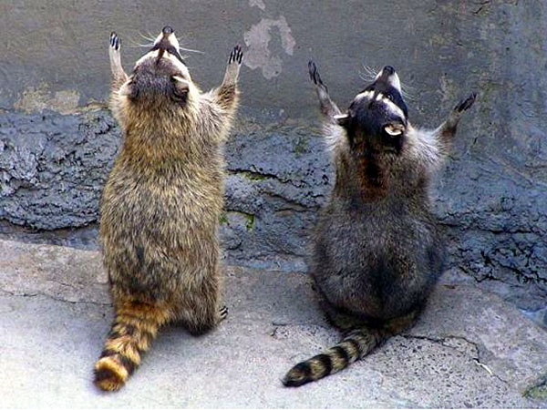
Plugins!!
Plugins.telerik.com

Slide 30
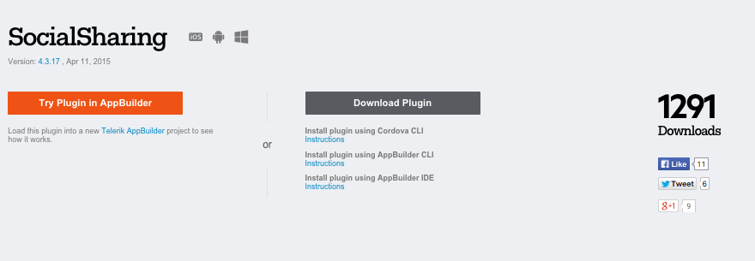
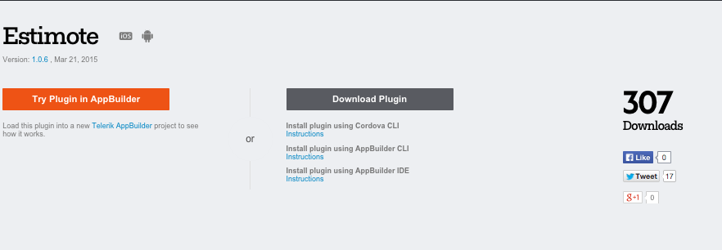
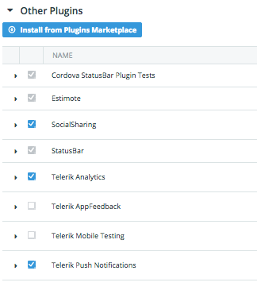
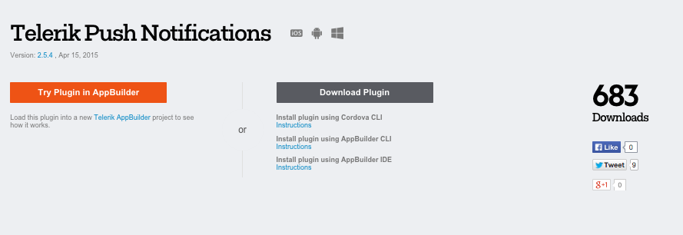
Integrate 3 plugins:
Install Custom plugins from the Plugin marketplace in-browser

Slide 31
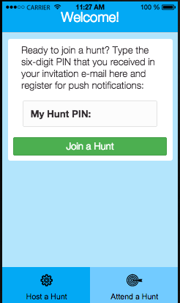
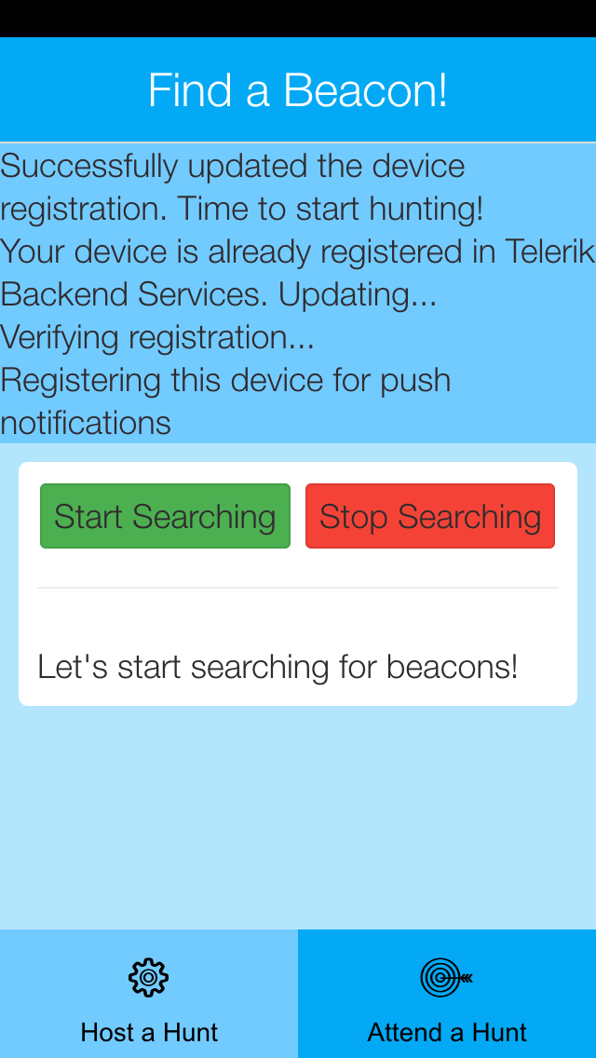
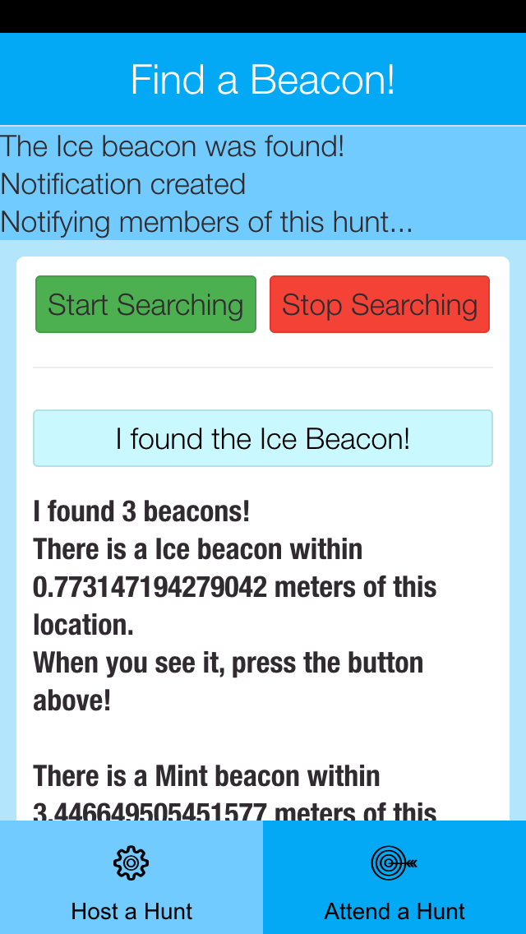
Build the app – Step 5 – Participant screen
Type the PIN, subscribe to a push segment, start searching, claim a beacon, send push

Slide 32
Build the app – Step 5 – Participant screen
Your Hunt is geofenced according to the segment you are subscribed to, per your hunt PIN which is stored in localStorage:
var customDeviceParameters = {
"Hunt":localStorage.getItem('registeredHunt')
};
…
currentDevice.register(customDeviceParameters)
.then(function (regData) {
model._onDeviceIsSuccessfullyRegistered();
}, function (err) {
model._onPushErrorOccurred(err.message);
});

Slide 33
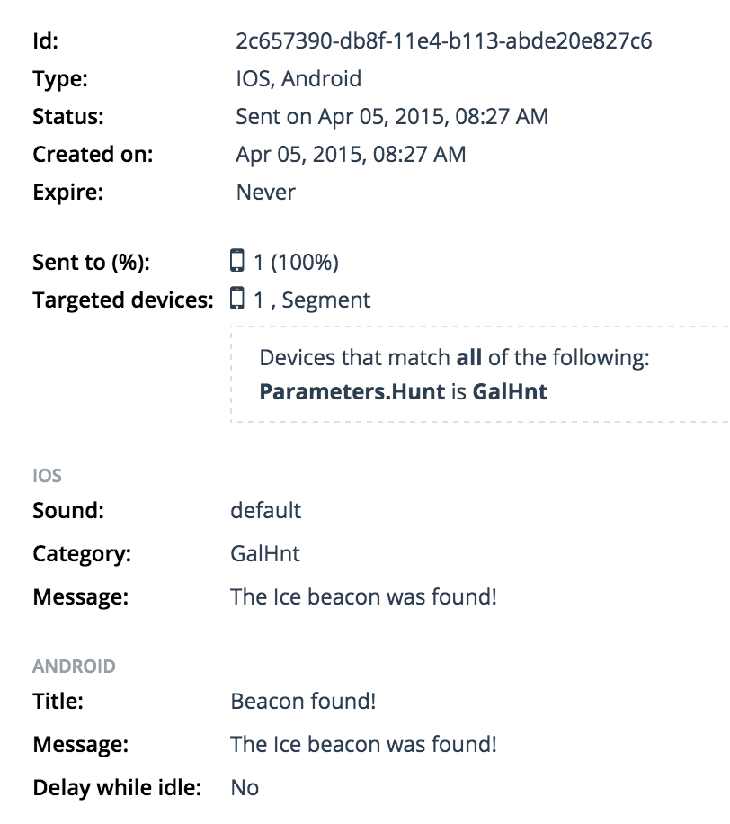
Push to a segment
The user claimed the ‘ice’ color beacon
Anyone signed into the GalHnt segment received this push

Slide 34

The final result!

Slide 35
Did you download Beacon Hunt? Ready to hunt for beacons?

Slide 36
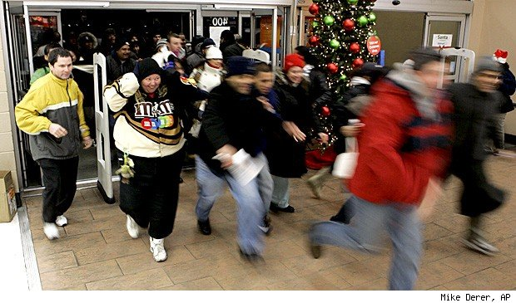
Let’s go! Hunt PIN: TELNXT

Slide 37
Thanks!
Jen Looper
Developer Advocate, Telerik
http://www.ladeezfirstmedia.com
@jenlooper

